Slide 1
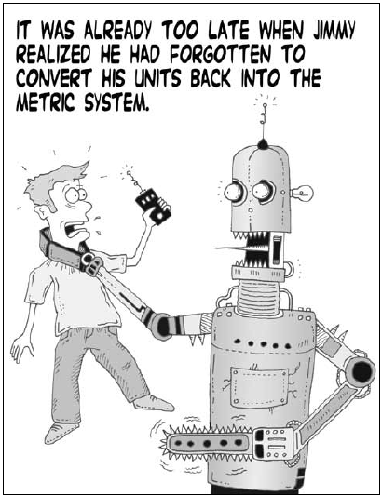
Chapter 11 Planning
Dr. Daisy Tang

Slide 2
Real-World Problems
Planning: the task of coming up with a sequence of actions that will achieve a goal
Search-based problem-solving agent
Logical planning agent
Complex/large scale problems?
For the discussion, we consider classical planning environments that are fully observable, deterministic, finite, static and discrete (in time, action, objects and effects)

Slide 3
Problems with Standard Search
Overwhelmed by irrelevant actions
Finding a good heuristic function is difficult
Cannot take advantage of problem decomposition

Slide 4
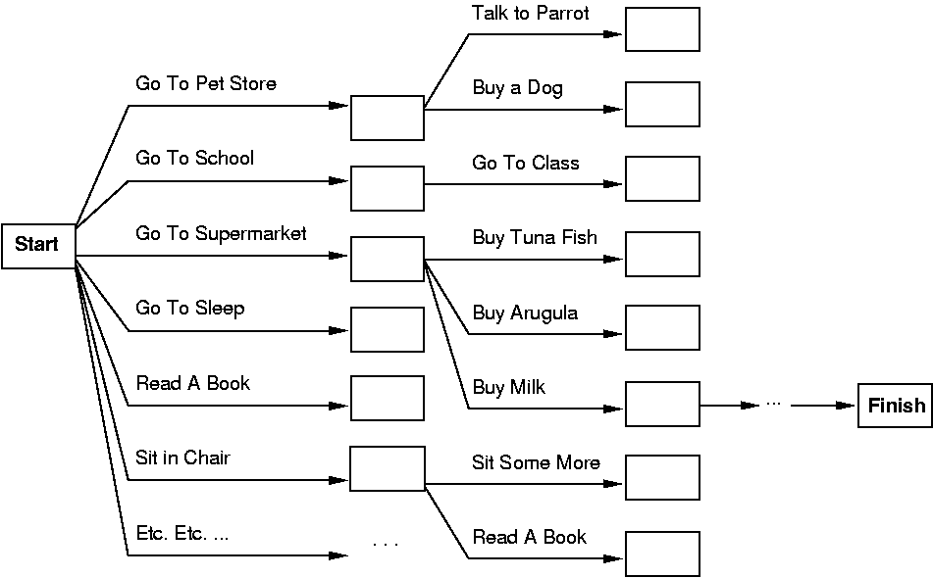
Example
Consider the task: get milk, bananas, and a cordless drill
Standard search algorithms seem to fail miserably
Why? Huge branching factor & heuristics

Slide 5
Problem Decomposition
Perfectly decomposable problems are delicious but rare
Partial-order planner is based on the assumption that most real-world problems are nearly decomposable
Be careful, working on some subgoal may undo another subgoal

Slide 6
Planning vs. Problem Solving
Planning agent is very similar to problem solving agent
Constructs plans to achieve goals, then executes them
Planning agent is different from problem solving agent in:
Representation of goals, states, actions
Use of explicit, logical representations
Way it searches for solutions

Slide 7
Planning vs. Problem Solving
Planning systems do the following:
divide-and-conquer
relax requirement for sequential construction of solutions
Problem Sol. Planning
States data structures logical sentences
Actions code preconditions/outcomes
Goal code logical sentences
Plan sequence from s₀ constraints on actions

Slide 8
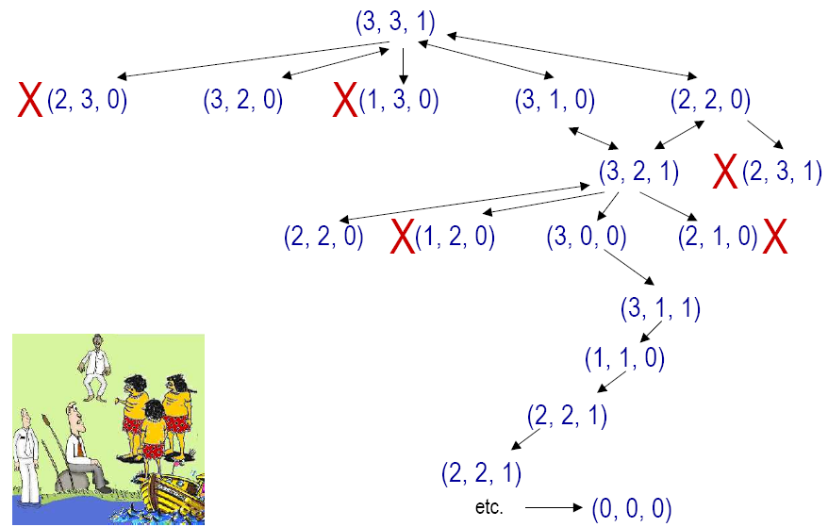
Famous Problem Solver Task: “Missionaries and Cannibals”

Slide 9
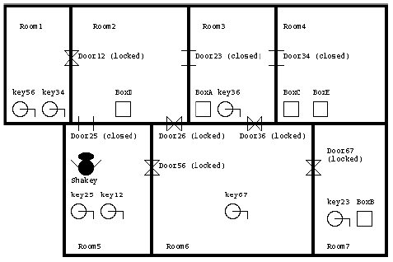
Planning-Based Approach to Robot Control
Job of planner: generate a goal to achieve, and then construct a plan to achieve it from the current state
Must define representations of:
Actions: generate successor state descriptions by defining preconditions and effects
States: data structure describing current situation
Goals: what is to be achieved
Plans: solution is a sequence of actions

Slide 10
Many AI Planners in History
Well-known AI Planners:
STRIPS (Fikes and Nilsson, 1971): theorem-proving system
ABSTRIPS (Sacerdoti, 1974): added hierarchy of abstractions
HACKER (Sussman, 1975): use library of procedures to plan
NOAH (Sacerdoti, 1975): problem decomposition and plan reordering

Slide 11
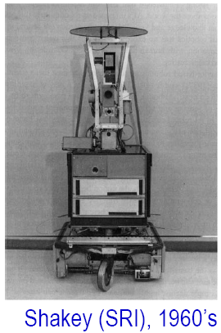
STRIPS-Based Approach to Robot Control
Use first-order logic and theorem proving to plan strategies from start to goal
STRIPS language:
“Classical” approach that most planners use
Lends itself to efficient planning algorithms
Environment: office environment with specially colored and shaped objects
STRIPS planner: developed for this system to determine the actions of the robot should take to achieve goals
Cost of Shakey: $100, 000

Slide 12
STRIPS
STRIPS (STanford Research Institute Problem Solver)
a restrictive way to express states, actions and goals, but leads to more efficiency
States: conjunctions of ground, function-free, and positive literals, such as At(Home) ^ Have(Banana)
Closed-world assumption is used
Goals: conjunctions of literals, may contain variables (existential), hence goal may represent more than one state
E.g. At(Home) ^ ¬ Have(Bananas)
E.g. At(x) ^ Sells(x, Bananas)
Actions: preconditions that must hold before execution and the effects after execution

Slide 13
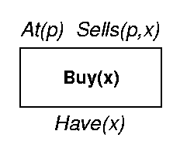
STRIPS Action Schema
An action schema includes:
action name & parameter list (variables)
precondition: a conjunction of function-free positive literals. Any variables in it must also appear in parameter list
effect: a conjunction of function-free literals (positive or negative)
add-list: positive literals
delete-list: negative literals
Example:
Action: Buy (x)
Precondition: At (p), Sells (p, x)
Effect: Have(x)

Slide 14
An Example of STRIPS World Model
A world model is a set of facts
The robot’s knowledge can be represented by the following predicates:
INROOM(x, r), where x is a movable object, r is a room
NEXTTO(x, t)
STATUS(d, s), where d is a door, s means OPEN or CLOSED
CONNECTS(d, rx, ry)
The world model in this figure can be represented with the above predicates, with the initial state and goal state
R1
D1
R2
S
B1

Slide 15
Shakey’s STRIPS World
Types of actions Shakey can make
Move from place to place:
GOTODOOR(S, dx):
PRECOND: INROOM(S, rk) ^ CONNECT(dx, rk, rm)
Effect:
add-list: NEXTTO(S, dx)
delete-list: null
GOTHRUDOOR(S, dx):
PRECOND: CONNECT(dx, rk, rm) ^ NEXTTO(S, dx) ^ STATUS(dx, OPEN) ^ INROOM(S, rk)
Effect:
add-list: INROOM(S, rm)
delete-list: INROOM(S, rk)

Slide 16
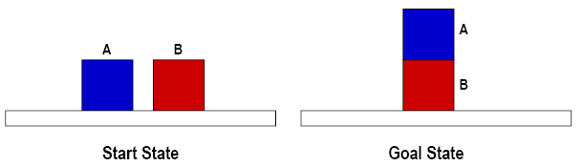
Simple Example of STRIPS-Style Planning
Goal state: ON(A, B)
Start state: ON(A, Table); ON(B, Table); EMPTYTOP(A); EMPTYTOP(B)
Operators:
Move(x, y)
Preconditions: ?
Add-list: ?
Delete-list: ?
Preconditions: ON(x, Table); EMPTYTOP(y)
Add-list: ON(x, y)
Delete-list: EMPTYTOP(y); ON(x, Table)

Slide 17
Challenges of AI and Planning
Closed world assumption: assumes that world model contains everything the robot needs to know: there can be no surprise
Frame problem: how to represent real-world situations in a manner that is computationally tractable

Slide 18
Planning with State-Space Search
Planning algorithms:
The most straightforward approach is to use state-space search
Forward state-space search (Progression)
Backward state-space search (Regression)

Slide 19
Problem Formulation for Progression
Initial state:
Initial state of the planning problem
Actions:
Applicable to the current state (actions’ preconditions are satisfied)
Goal test:
Whether the state satisfies the goal of the planning
Step cost:
Each action is 1

Slide 20
Progression
A plan is a sequence of STRIPS operators
From initial state, search forward by selecting operators whose preconditions can be unified with literals in the state
New state includes positive literals of effect; the negated literals of effect are deleted
Search forward until goal unifies with resulting state
This is state-space search using STRIPS operators

Slide 21
Regression
A plan is a sequence of STRIPS operators
The goal state must unify with at least one of the positive literals in the operator’s effect
Its preconditions must hold in the previous situation, and these become subgoals which might be satisfied by the initial conditions
Perform backward chaining from goal
Again, this is just state-space search using STRIPS operators

Slide 22
STRIPS Program To Control Shakey
Work on board

Slide 23
Heuristics for State-Space Search
How to find an admissible heuristic estimate?
Distance from a state to the goal?
Look at the effects of the actions and at the goals and guess how many actions are needed
NP-hard
Relaxed problem
Subgoal independence assumption:
The cost of solving a conjunction of subgoals is approximated by the sum of the costs of solving each subgoal independently

Slide 24
Relaxation Problem
Idea: removing all preconditions from the actions
Almost implies that the number of steps required to solve a conjunction of goals is the number of unsatisfied goals
There may be two actions, each of which deletes the goal literal achieved by the other
Or, some action may achieve multiple goals
Combining relaxation with subgoal independence assumption → exact # of unsatisfied goals

Slide 25
Removing Negative Effects
Generate a relaxed problem by removing negative effects:
Empty-delete-list heuristic
Quite accurate, but computing it involves running a simple planning algorithm

Slide 26
Extensions – ADL
State: positive and negative literals
Open world assumptions: unmentioned literals are unknown
Effect: P ^ ¬ Q means add P and ¬ Q and delete ¬ P and Q
Goal: quantified variables; conjunction and disjunction
Effects: conditional effects
when P: E means E is an effect only if P is satisfied
Equality predicate (x = y)
Variables can have types (p: Plane)

Slide 27
Example: Air Cargo Transport
Loading/unloading cargo onto/off planes and flying it from place to place.
Actions: Load, Unload, and Fly
States:
In(c, p): cargo c is inside plane p
At(x, a): object x (plane/cargo) at airport a

Slide 28
Example: Spare Tire Problem
Initial state: a flat tire on the axle and a good spare tire in the trunk
Goal state: have a good spare tire properly mounted onto the car’s axle

Slide 29
Total-Order Planning
Forward/backward state-space searches are forms of totally ordered plan search
explore only strictly linear sequences of actions directly connected to the start or goal
cannot take advantages of problem decomposition

Slide 30
Partial-Order Planning
Idea:
works on several subgoals independently
solves them with subplans
combines the subplans
flexibility in ordering the subplans
least commitment strategy:
delaying a choice during search
Example, leave actions unordered, unless they must be sequential

Slide 31
POP Example
Putting on a pair of shoes:
Goal(RightShoeOn ^ LeftShoeOn)
Init()
Action: RightShoe
PRECOND: RightSockOn
EFFECT: RightShoeOn
Action: RightSock
PRECOND: None
EFFECT: RightSockOn
Action:LeftShoe
PRECOND: LeftSockOn
EFFECT: LeftShoeOn
Action: LeftSock
PRECOND: None
EFFECT: LeftSockOn

Slide 32
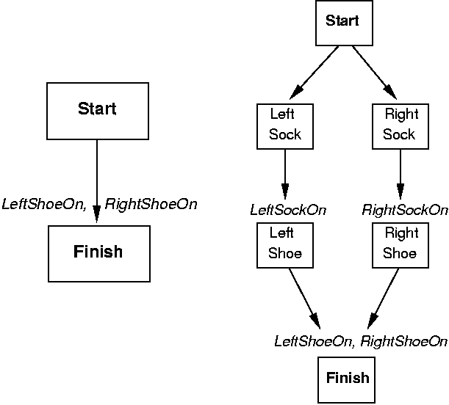
POP Example

Slide 33
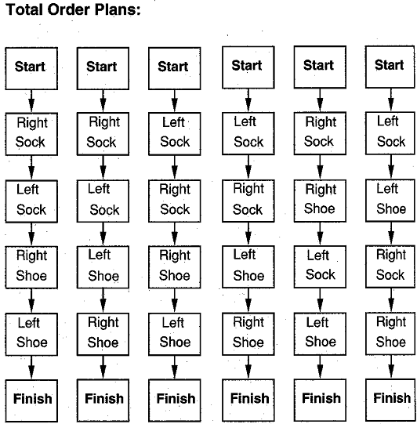
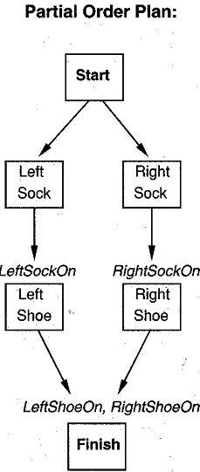
Partial Order Plan to Total Order Plan

Slide 34
How to Define Partial Order Plan?
A set of actions that make up the steps of the plan
A set of ordering constraints:
A before B
A set of causal links:
A achieves p for B
May be conflicts if C has the effect of and if C comes after A and before B
A set of open preconditions:
a precondition is open if it is not achieved by some action in the plan

Slide 35
The Initial Plan
Initial plan contains:
Start:
PRECOND: none
EFFECT: Add all propositions that are initially true
Finish:
PRECOND: Goal state
EFFECT: none
Ordering constraints:
Causal links: {}
Open preconditions: {preconditions of Finish}

Slide 36
Next…
Successor function
arbitrarily picks one open precondition p on an action B and generates a successor plan for every possible consistent way of choosing an action A that achieves p
Consistency:
Causal link and the ordering constraint are added ( )
Resolve conflict: add or
Goal test:
There are no open preconditions

Slide 37
Example: Final Plan
The final plan has the following components:
Actions: {RightSock, RightShoe, LeftSock, LeftShoe, Start, Finish}
Orderings: {RightSock ‹ RightShoe, LeftSock ‹ LeftShoe}
Open preconditions: {}
Links:

Slide 38
Example Algorithm for POP
POP: A sound, complete partial order planner using STRIPS representation

Slide 39
POP Example: Flat Tire

Slide 40
Strengths of POP
The causal links lead to early pruning of portions of the search space because of irresolvable conflicts
The solution is a partial-order plan
linearizations produce flexible plans

Slide 41
From Problem Solvers to Planners
Key ideas:
“Open up” representation of states, goals, and actions
Use descriptions in a formal language – FOL
States/goals represented by sets of sentences
Actions represented by logical description of preconditions and effects
Enables planner to make direct connections between states and actions
Planner can add actions to plan whenever needed, rather than in strictly incremental fashion
No necessary connection between order of planning and order of execution
Most parts of the world are independent of most other parts of the world
Conjunctions can be separated and handled independently
Divide-and-conquer algorithms

Slide 42
Summary of Planning Problem
Planning agents use look-ahead to find actions to contribute to goal achievement
Planning agents differ from problem solvers in their use of more flexible representation of states, actions, goals, and plans
The STRIPS language describes actions in terms of preconditions and effects
Principle of least commitment is preferred
POP is a sound and complete algorithm for planning using STRIPS representation

Slide 43
In-Class Exercise 11.1
The monkey-and-bananas problem is faced by a monkey in a lab with some bananas hanging out of reach from the ceiling. A box is available that will enable the monkey to reach the bananas if he climbs on it.
Initially the monkey is at A, bananas at B, the box at C. The monkey and box have height Low, but if the monkey climbs onto the box he will have height High, the same as the bananas.

Slide 44
Exercise 11.1 Cont’d
Actions:
Go from one place to another
Push an object from one place to another
ClimbUp onto or ClimbDown from an object
Grasp or Ungrasp an object
The results of a Grasp is that the monkey holds the object if the monkey and object are in the same place at the same height.
Questions
Write down the initial state description
Write down the goal state (monkey has banana)
Write the six action schemas
Generate the plan

Slide 45
In-Class Exercises 11.2
Describe the differences and similarities between problem solving and planning.

Slide 46
In-Class Exercises 11.3
Explain why dropping negative effects from every action schema in a planning problem results in a relaxed problem.

